Slide 1
Emoji-face-keyboard
Team 4
곽준호 김선준 박지호 박종석

Slide 2
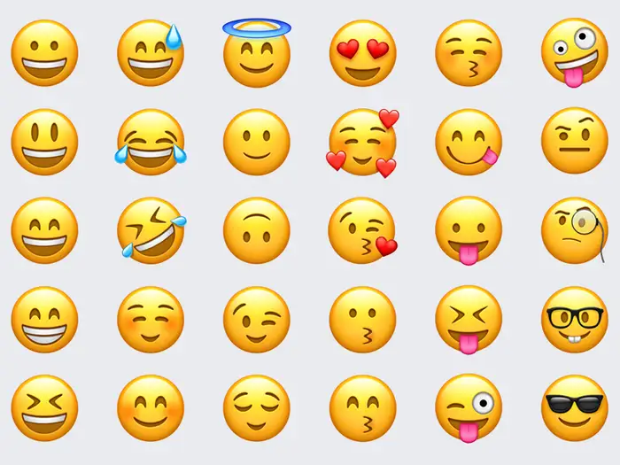
Emoji
Language for everyone in the digital world.
Designed to add emotional nuance to otherwise flat text.
In terms of human behavior and context sensing, emoji helps represent “internal state - emotion”.

Slide 3
Target users and the problem
Target users
Young people who want to send emoji in quick & intuitive way.
Elderly people who have problems finding emoji they want.
Problem
It is hard and inconvenient to find specific emoji from the list.
Finding emoji with keyword is annoying, especially for face emojis.

Slide 4
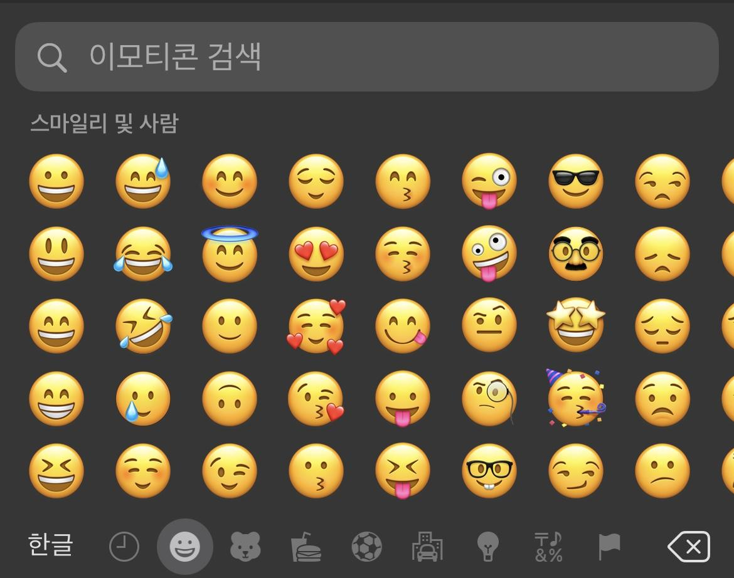
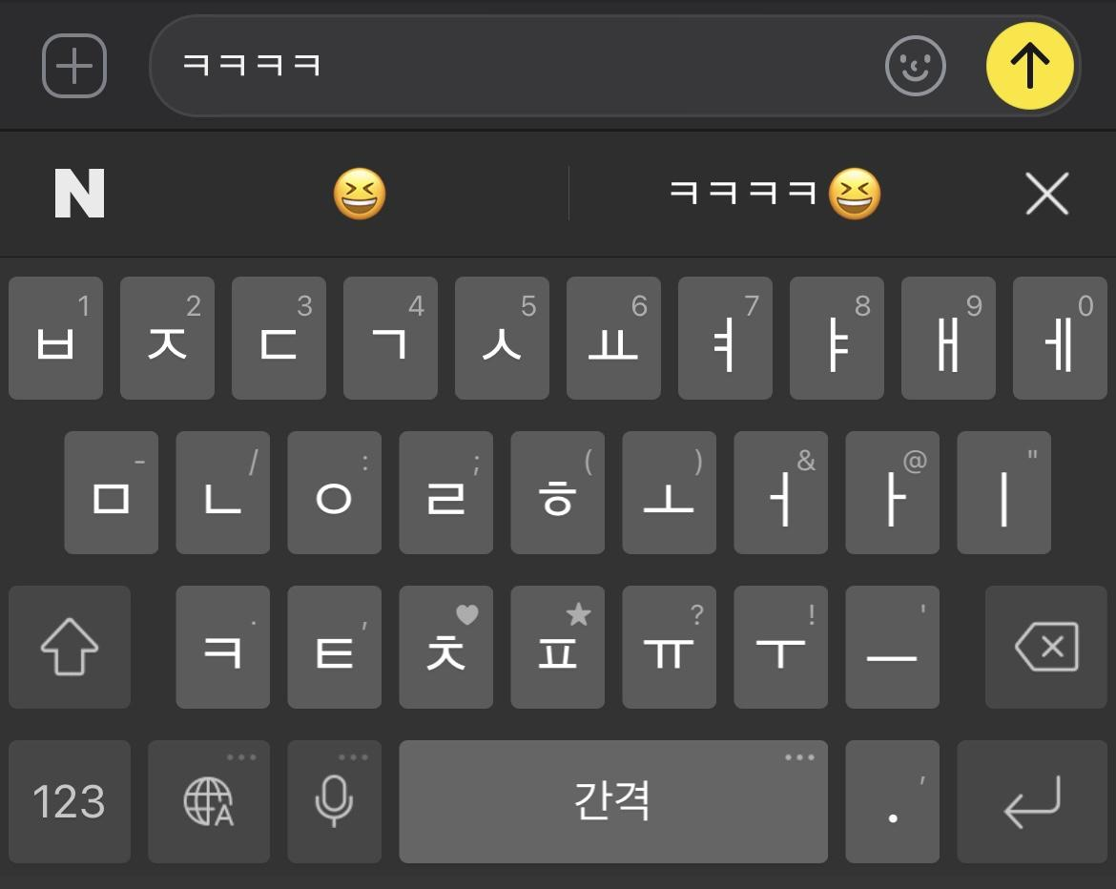
Existing solutions and their limitations
Three existing emoji interfaces
Finding emoji from the list of grid.
Searching emoji with keywords.
Recommendation through text context recognition
iOS keyboard
Naver keyboard
Notes:
현재 사용되는 emoji 인터페이스
grid 형태의 list에서 눈으로 찾기 & keyword로 검색 (iOS, android 기본 키보드)
type하는 단어를 인식해서 추천 (네이버 키보드, slyder 키보드)

Slide 5
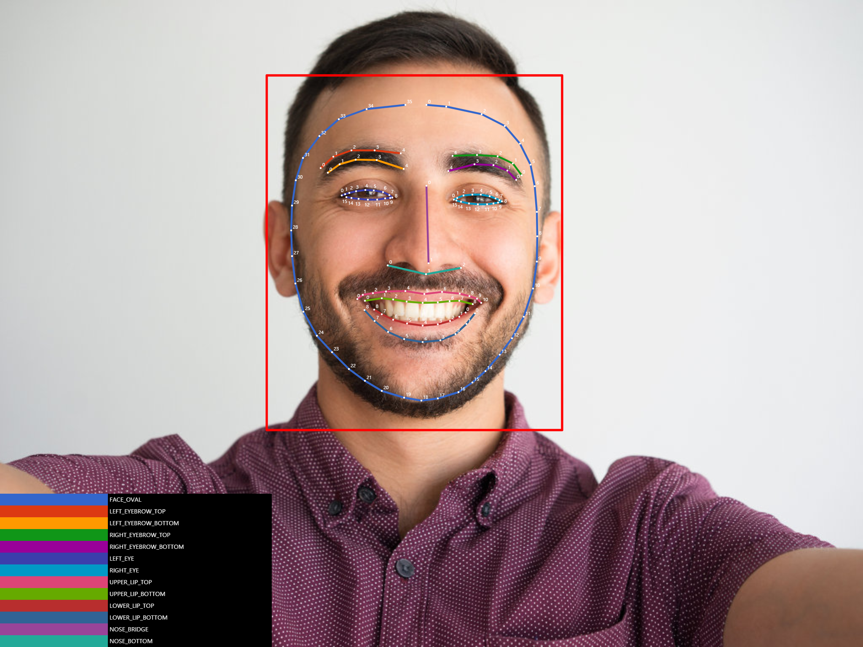
The key solution idea to tackle the problem
Using facial recognition with front camera, emoji-keyboard recommends appropriate emoji.
People can select desired emoji accurately and intuitively, without scrolling lists or searching with keyword.
Notes:
오늘날의 화려한 ml dl vision 관련 얘기로 시작
face detection을 할수있음

Slide 6

Usage scenarios - 1
James is going home, carrying baggage in his right hand.
He got an invitation message from his friend, and wants to respond with an smiling emoji to express his emotion.
He smiles to camera, and emoji-face-keyboard recommends him several smiling emojis.
He picks one of emoji from the list, using only his left hand.

Slide 7




Usage scenarios - 2
Today is James’ birthday. James is going to take a photo of his birthday party and post it on SNS.
He wants to decorate his picture with emojis that show his happy emotion.
He smiles to camera, and emoji-face-keyboard recommends him several smiling emojis.
He picks emojis from the list and decorates his picture nicely.

Slide 8
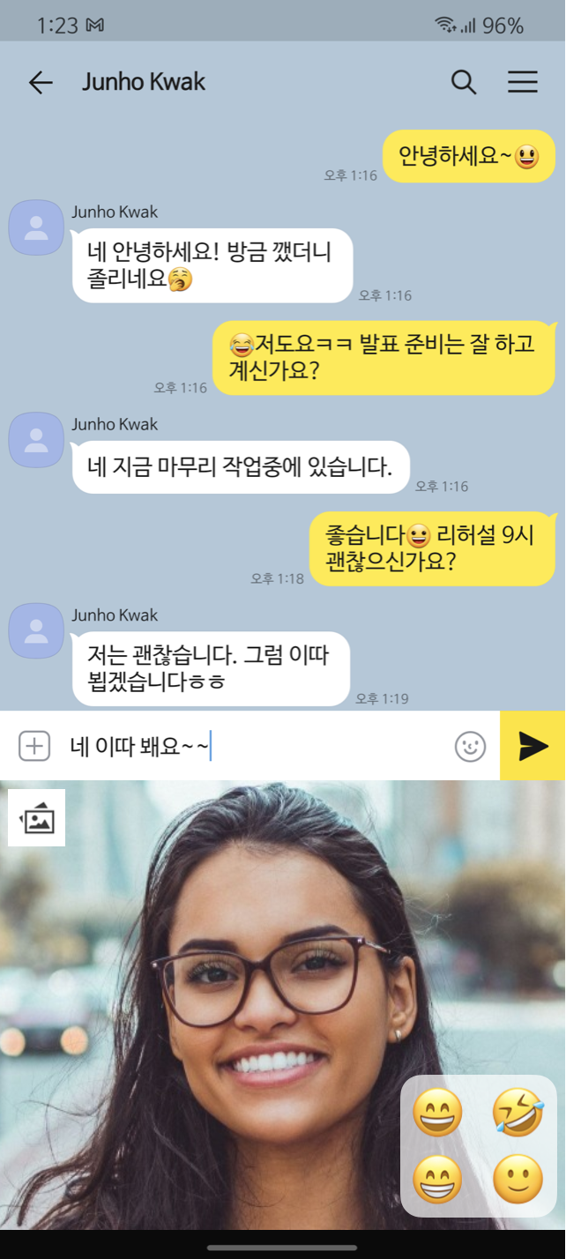








System overview
captured
facial expression
coordinate of
facial landmarks
emoji recommendation engine
Face detection
Neural Network
emojis

Slide 9
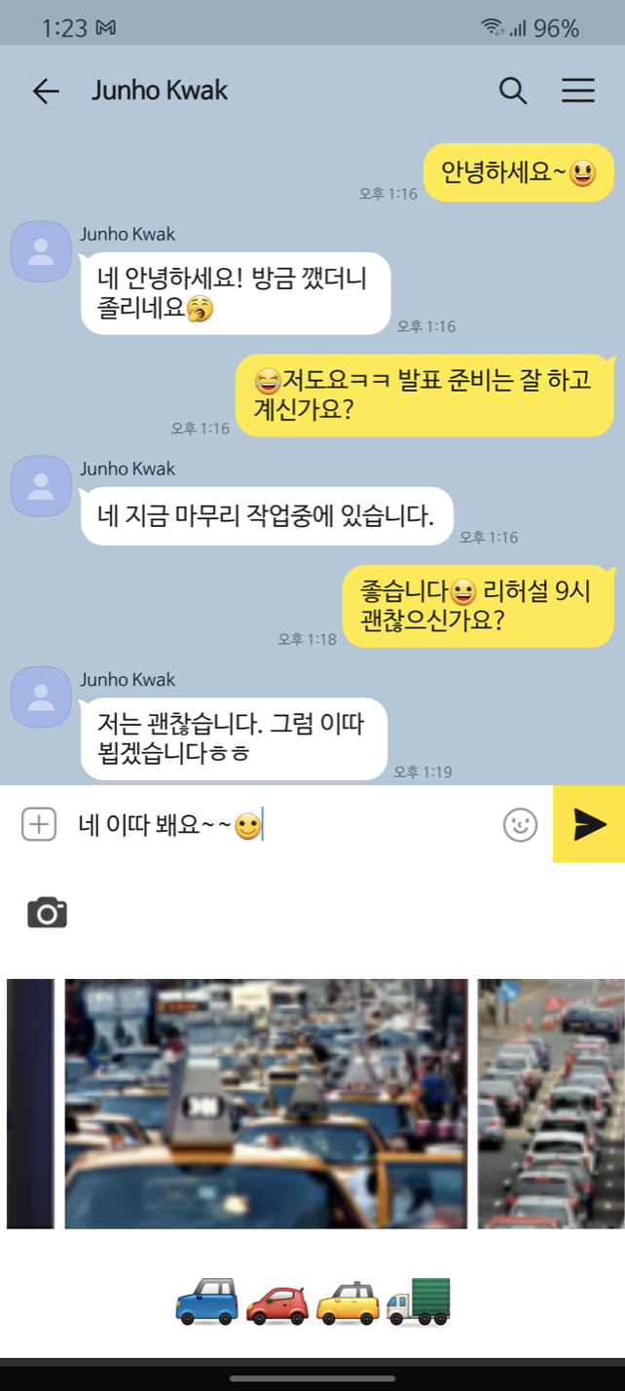
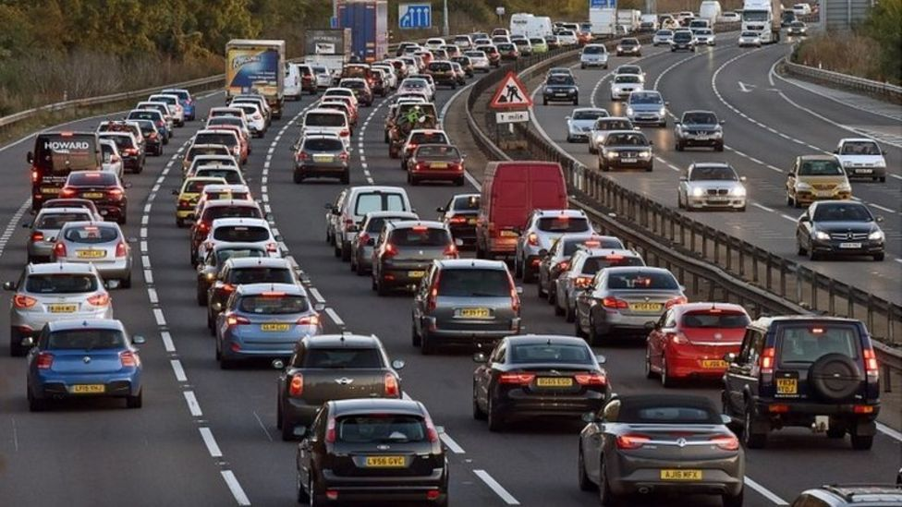

System overview (additional feature)
picture from gallery
detected objects
emoji recommendation engine
Object detection
Neural Network
emojis

Slide 10
Expected challenges and solutions
Challenges/Solutions
It is hard to recommend emoji only by facial expressions - There are too many emojis. We need additional interface that allows users to use several emojis.
Facial expressions vary by people. Calibration is needed to support personalization.
Mapping landmark to emojis is challenging. We need to find effective way to solve it.
It should be a application that replaces the existing keyboard. Basic keyboard functions should also be implemented to work well.

Slide 11
Evaluation strategy
Accuracy - Is recommended emoji fit with user’s intentions?
Ask the user to make a specific facial expression, and check if the recommendation matches.
Latency - Is recommendation fast enough?
Measure how long it takes to recommend emoji.

Slide 12
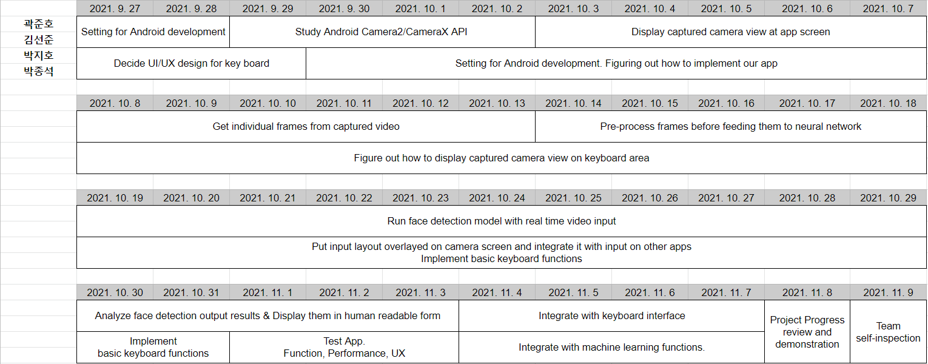
Overall project plan

Slide 13
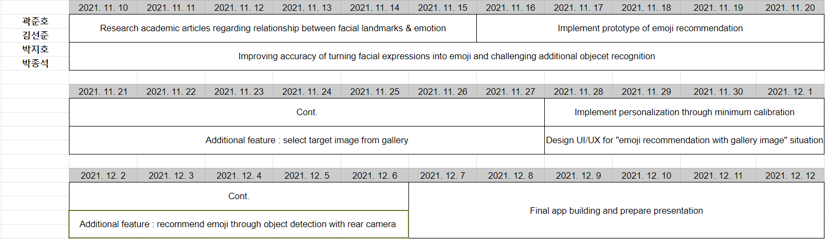
Overall project plan

Slide 14
Final deliverable and success criteria
Accuracy
Intended emoji should be recommended with 80% of accuracy.
Latency
Recommendation should be done in 1 second.
UI/UX
It should be intuitive to use.

